Slide 1
Title title title title title title title title title title title title title title title title title
Name Surname ¹, Name Surname ¹, Name Surname ¹, Name N. Surname ¹,
Name Surname¹, Name Surname ², and Name Surname^{1,2}
¹ Institute of High Pressure Physics Polish Academy of Sciences, Warsaw, Poland,
² The name of collaborating unit, City, Country
e-mail: responder@unipress.waw.pl

Slide 2
Outline (not obligatory)
Could be used by inexperienced or stressed presenters.
It organizes the presentation and allows you to follow the path.
Suggested convention:
  Introduction / Motivation
  Results
  Discussion
  Conclusions
How to prepare a good presentation?
See slide #7 – some suggestions from prof. Zlatko Sitar
(North Carolina State University)
Storytelling in presentations – slide #8

Slide 3

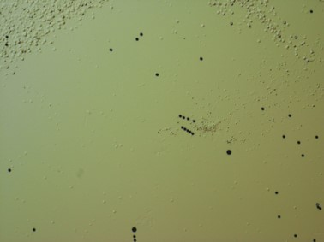

Headlines – font size 30
Up to three images/figures on a slide.
Font size:
  Main text – 18 or 16
Figure description font 16
Figure description font 16
Figure description font 16

Slide 4

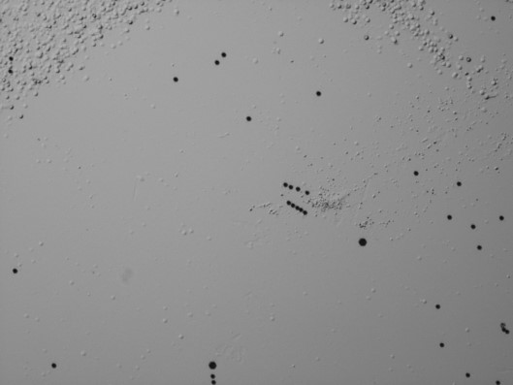
How many objects can there be on a slide?
Suggested image sizes:
  two per page - width 13 cm
  if three on a page - width 10 cm
Any photograph or text must not touch the edge of the slide. Sometimes projectors cut off the edges of slides.

Slide 5
Why the black background?
Some images, especially those with low contrast, are better presented on a black background.

Slide 6
Suggestions for text and images
Up to three images on a slide.
Suggested image sizes:
  two per page - width 13cm,
  if three on a page - width 10cm.
Suggested font color: black on white or white on black.
Suggested one additional color to highlight something in the text.
Bolding is welcome.
Font size:
  Main text – 18 or 16 (smaller fonts can be used in on-line presentations),
  Headlines – 30,
  Figure caption font 16,
  Interline - precisely 20pts.
Any photo graph or text must not touch the edge of the slide. Sometimes projectors cut off the edges of slides.
Animations - modest and small amount (one or two). Sometimes it is better to create a new slide than to throw another animation on the slide.

Slide 7
About writing an article but also about making presentations
Decide on the STORY you want to tell.
Write down the message you want to convey in ONE sentence. If you can’t do that, no one else can.
Decide what data you need to support the story. Decide how you will present the data: graph (what kind?), table,…
Make sure all the data you use is self-consistent i.e. not contradictory.
DO NOT include data just because you have it; this is the major distraction and will detract from the message, i.e., the reader is going to be confused.
At the end, ask yourself: Why should anyone read my paper? Keep in mind that all publications are for the benefit of the community and not the author.
You may have heard the old adage that “good data speaks for itself”. I disagree!
Good data enables you to tell a good story (and remember, you may not need all the good data you have collected to tell it.)

Slide 8
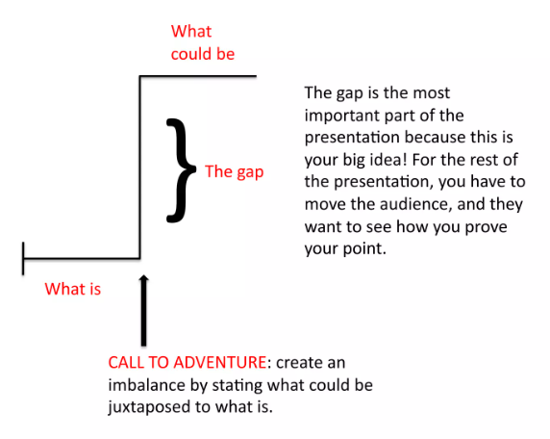
The idea of storytelling in presentations
Credit: https://www.slideshare.net/agencysparks/persuasive-storytelling after Nancy Duarte

Slide 9
Transition between presentation storylines

Slide 10
Thank you for your attention

Slide 11
Thank you for your attention

